Slide 1
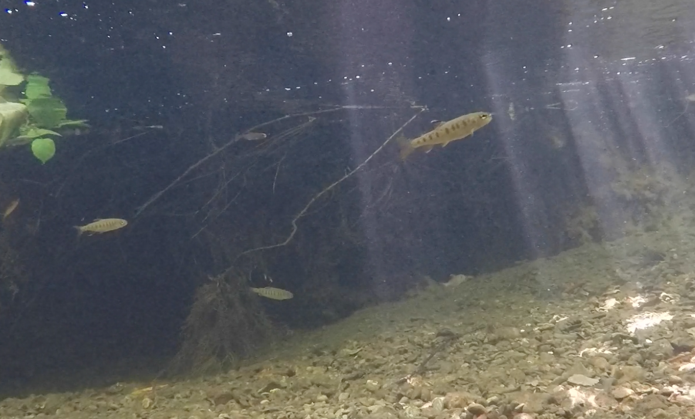
Bayesian Analysis of Steelhead Trout Foraging Behavior
Keane Flynn, James Golden, Morgan Byrne

Slide 2
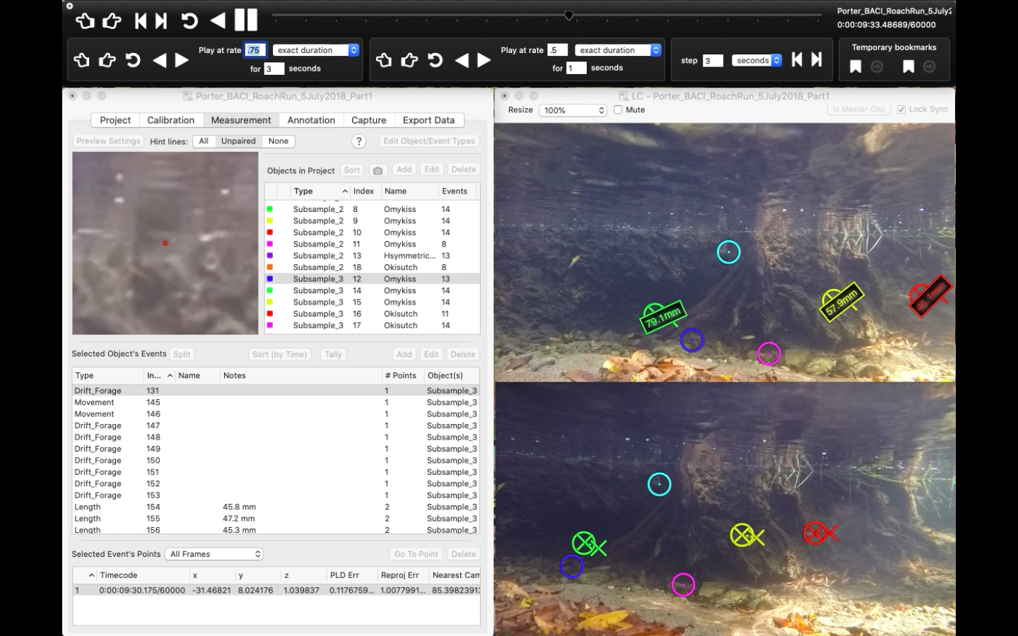
Challenges of Fish Foraging Behavior
No standardized or consistent metrics for behavioral data analysis
Previous analyses: no link between quantitative data from videogrammetry and qualitative foraging behavior data*
*Vivancos & Closs 2015
Notes:
Keane

Slide 3
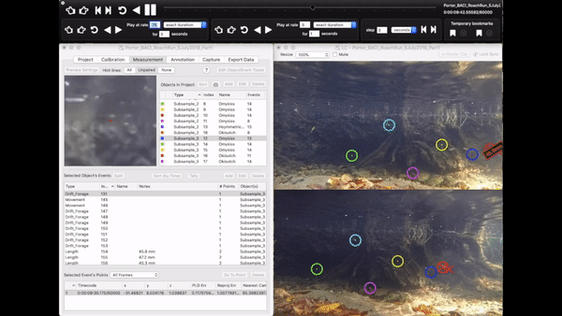
Underwater Video Monitoring: Fish Behavior
Notes:
Keane

Slide 4
Behavioral Definitions
Drift Forage: fish holding approximately the same focal position in the water while intercepting drifting prey
Search Forage: foraging at inconsistent suspended focal points throughout the water column
Benthic Forage: capturing prey along the benthos while covering large foraging patches
“Movement”: non-foraging behaviors displayed by fish, either moving within the water column or remaining in the same focal position
Attack: fish rapidly approaching another fish in an aggressive manner with or without making contact
Surface Strike:fish make a foraging attempt at prey on the surface or just under the surface
Notes:
Keane: text boxes are animated to fade in when you click

Slide 5
Hypotheses
H1: We hypothesize that fish length, distance travelled per unit time, nearest neighbor distance, and occupied volume will be strong quantitative proxies for shifts in foraging behavior
H2: Leveraging a Bayesian analytical framework with weakly informed priors will result in convergent posterior values for the quantitative metrics listed in H1
Notes:
Keane: text boxes are animated to fade in when you click

Slide 6
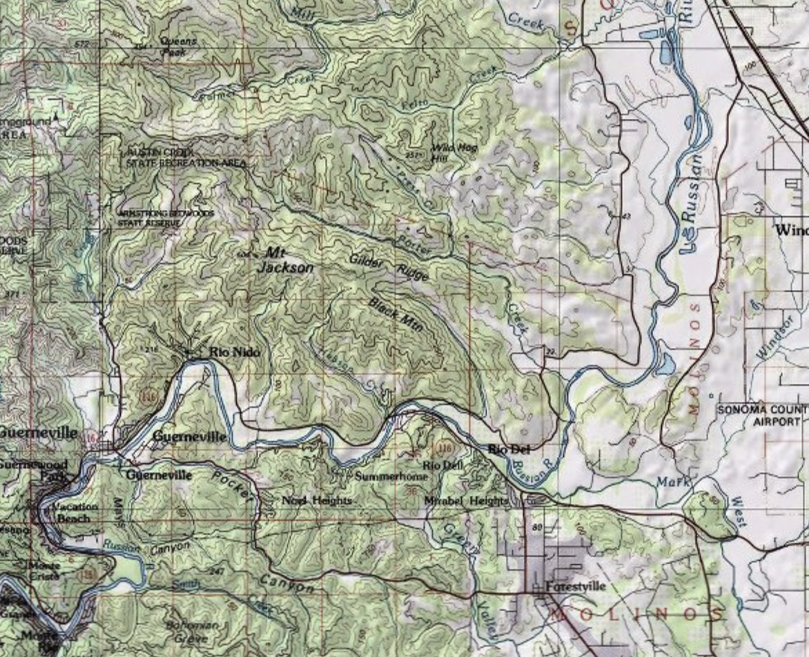
Data Collection
Porter Creek: Sonoma County, California (Russian River watershed)
Intermittent stream
Characterized by successive pool-riffle habitat units
6 sampling sites: in-situ stereo camera set up (GoPro Hero 4)
Vidsync software for post processing
Notes:
Morgan

Slide 7
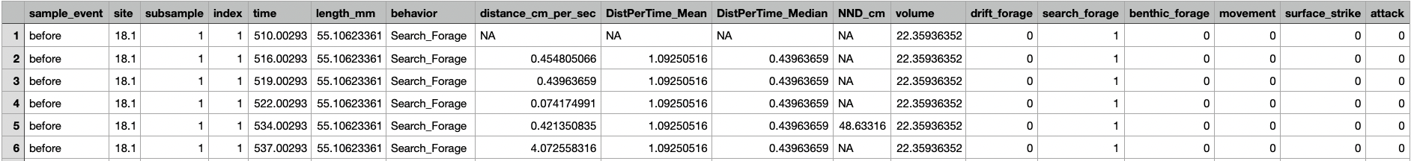
What Data are we Working With?
Observational data of steelhead foraging behavior:
Qualitative (foraging behavior)
Quantitative
Swimming speed
Nearest neighbor distance (NND)
Volume occupied (cm³)
Fork length
Data Modifications:
Each behavior was assigned a 0 (not performed) or 1 (performed)
Sites were assigned integer values (i.e. site 18.1 was site 1)
Notes:
Morgan

Slide 8
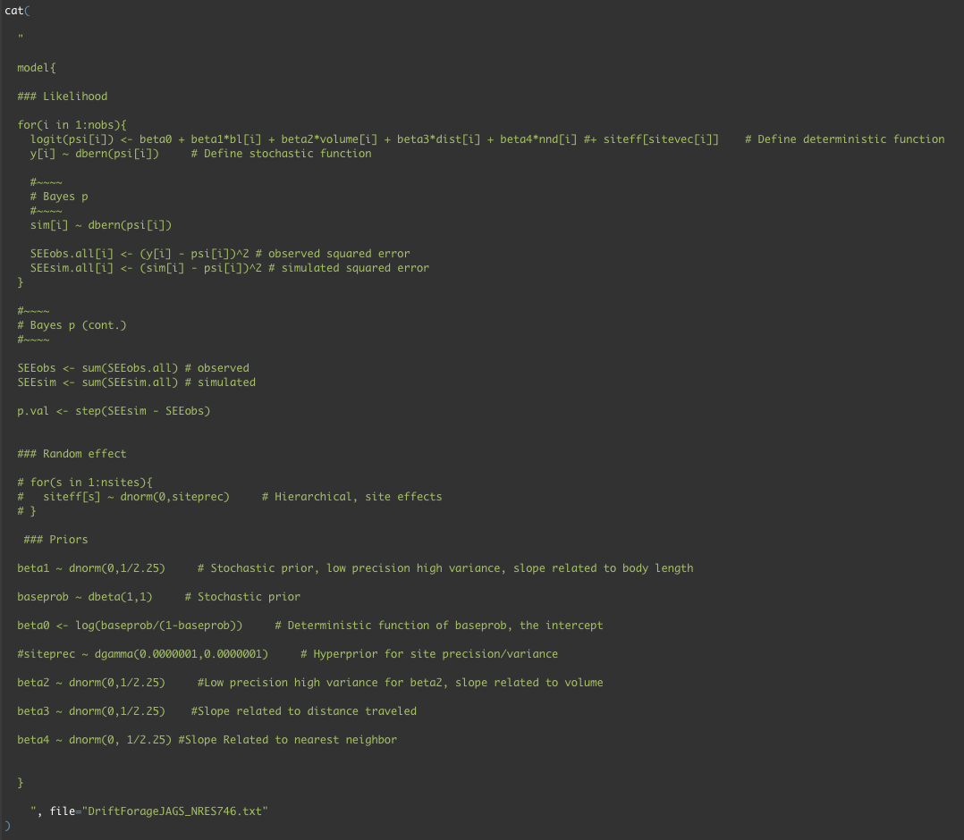
Modeling Fish
Foraging Behavior
Bayesian framework using JAGS in R
Analysis of 6 fish behaviors using separate models for each:
Drift Foraging
Attack
Search Foraging
Surface Strike
Benthic Foraging
Movement
Notes:
Morgan
These data were modeled in a Bayesian framework using JAGS in R
We conducted an analysis of 6 fish behaviors using separate models for each: drift foraging, search foraging, benthic foraging, attack, surface strike, and movement behaviors

Slide 9
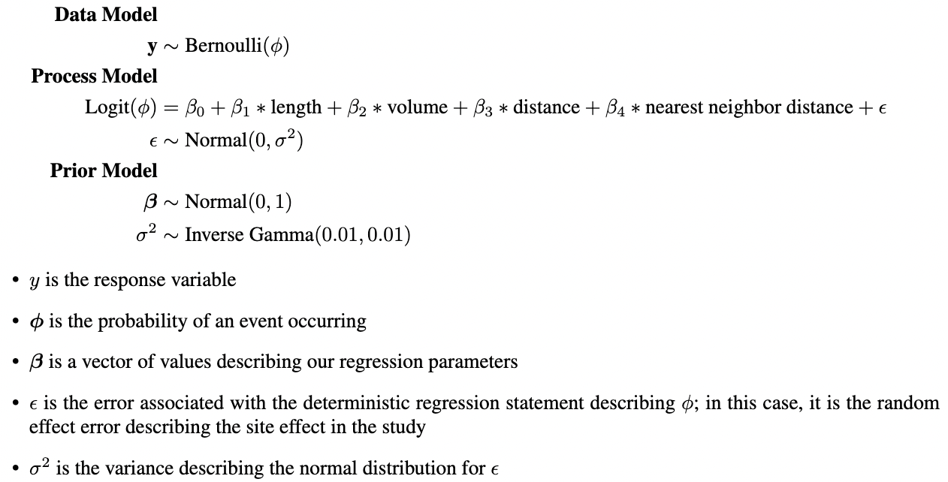
Model Statement
Notes:
Morgan
Our model statement consisted of one data model, 2 process models, and 2 prior models, which we will look at in more detail later.
Our variable y represents the response variable (whether or not the behavior was performed)
Our phi is the probability of the event (behavior) occurring
Beta is a vector of values describing our regression parameters
Epsilon is the error associated with the deterministic regression statement describing phi; in this case, it is the random effect error describing the site effect in the study
Sigma2 is the variance describing the normal distribution for epsilon

Slide 10
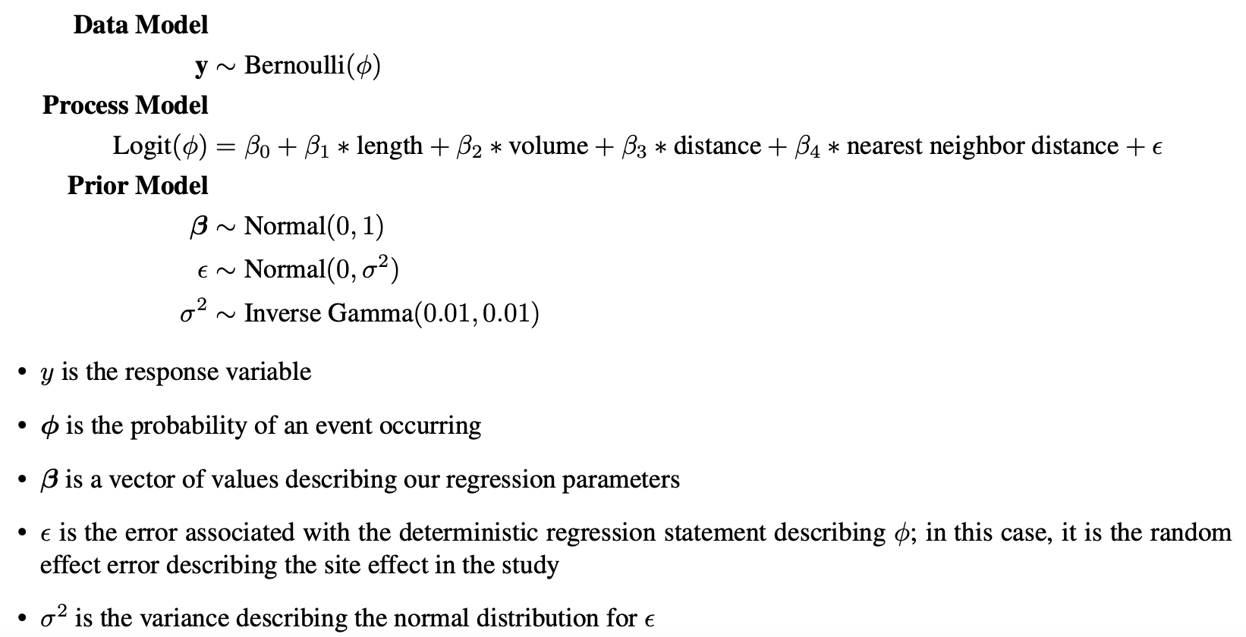
Model Statement: Data Model
The behavior data y in the format of 0 and 1 (0 being the behavior was not performed, 1 being the behavior was performed) is distributed by a Bernoulli distribution with a behavior probability of 𝜙
Notes:
Morgan
When we look at our data model, we see that the behavior data y is in the format of 0 and 1 (0 being that the behavior was not performed, 1 being that the behavior was performed) and is distributed by a Bernoulli distribution with a behavior probability of phi

Slide 11
Model Statement: Process Model
The behavior probability 𝜙 is logit linked to a deterministic function described by the covariates (length, volume, distance, nearest neighbor distance) and their respective parameters 𝛽 as well as the random site effect 𝝐
Notes:
Morgan
When looking at our first process model, we see that the behavior probability phi is logit linked to a deterministic function described by the covariates (length, volume, distance, nearest neighbor distance) and their respective parameters Beta as well as the random site effect epsilon

Slide 12

Model Statement: Process Model
The 𝝐 (random effect) is distributed by a Normal distribution with a mean of 0 and a variance 𝜎²
Notes:
Morgan
Our second process model describes epsilon as a normal distribution with a mean of 0 and a variance of sigma2

Slide 13
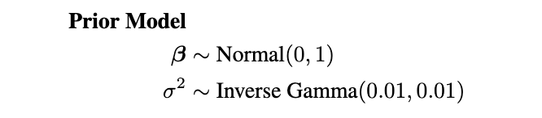
Model Statement: Prior Models
The 𝛽 (covariate parameters) and 𝜎² (the variance of the random effect) are described by uninformative/vague priors
Notes:
Morgan
Our prior models describing Beta (the covariate parameters) and sigma2 (the variance of the random effect) have uninformative or vague distributions

Slide 14
Covariates and Parameters
Parameter | Covariate
𝛽₀ | N/A (intercept)
𝛽₁ | Fish Length (mm)
𝛽₂ | Volume Occupied (cm³)
𝛽₃ | Distance (cm/sec)
𝛽₄ | Nearest Neighbor Distance (cm)
𝝐 | Random Effect (Site Effect)
𝜎² | Variance of Site Effect
Which covariates inform which parameter estimates?
Notes:
Morgan
This table describes which covariate data informs which parameter estimates in our model:
Beta0 is the probability of the behavior occurring in the absence of all covariates;
Beta1 informs the probability of the behavior occurring in relation to fish length;
Beta2 informs the probability of the behavior occurring in relation to the volume occupied by the fish;
Beta3 informs the probability of the behavior occurring in relation to the distance travelled by the fish;
Beta4 informs the probability of the behavior occurring in relation to the nearest neighbor distance of the fish;
Epsilon informs the probability of the behavior occurring in relation to the random effect site effect;
Lastly, Sigma2 is the variance of the site effect.

Slide 15
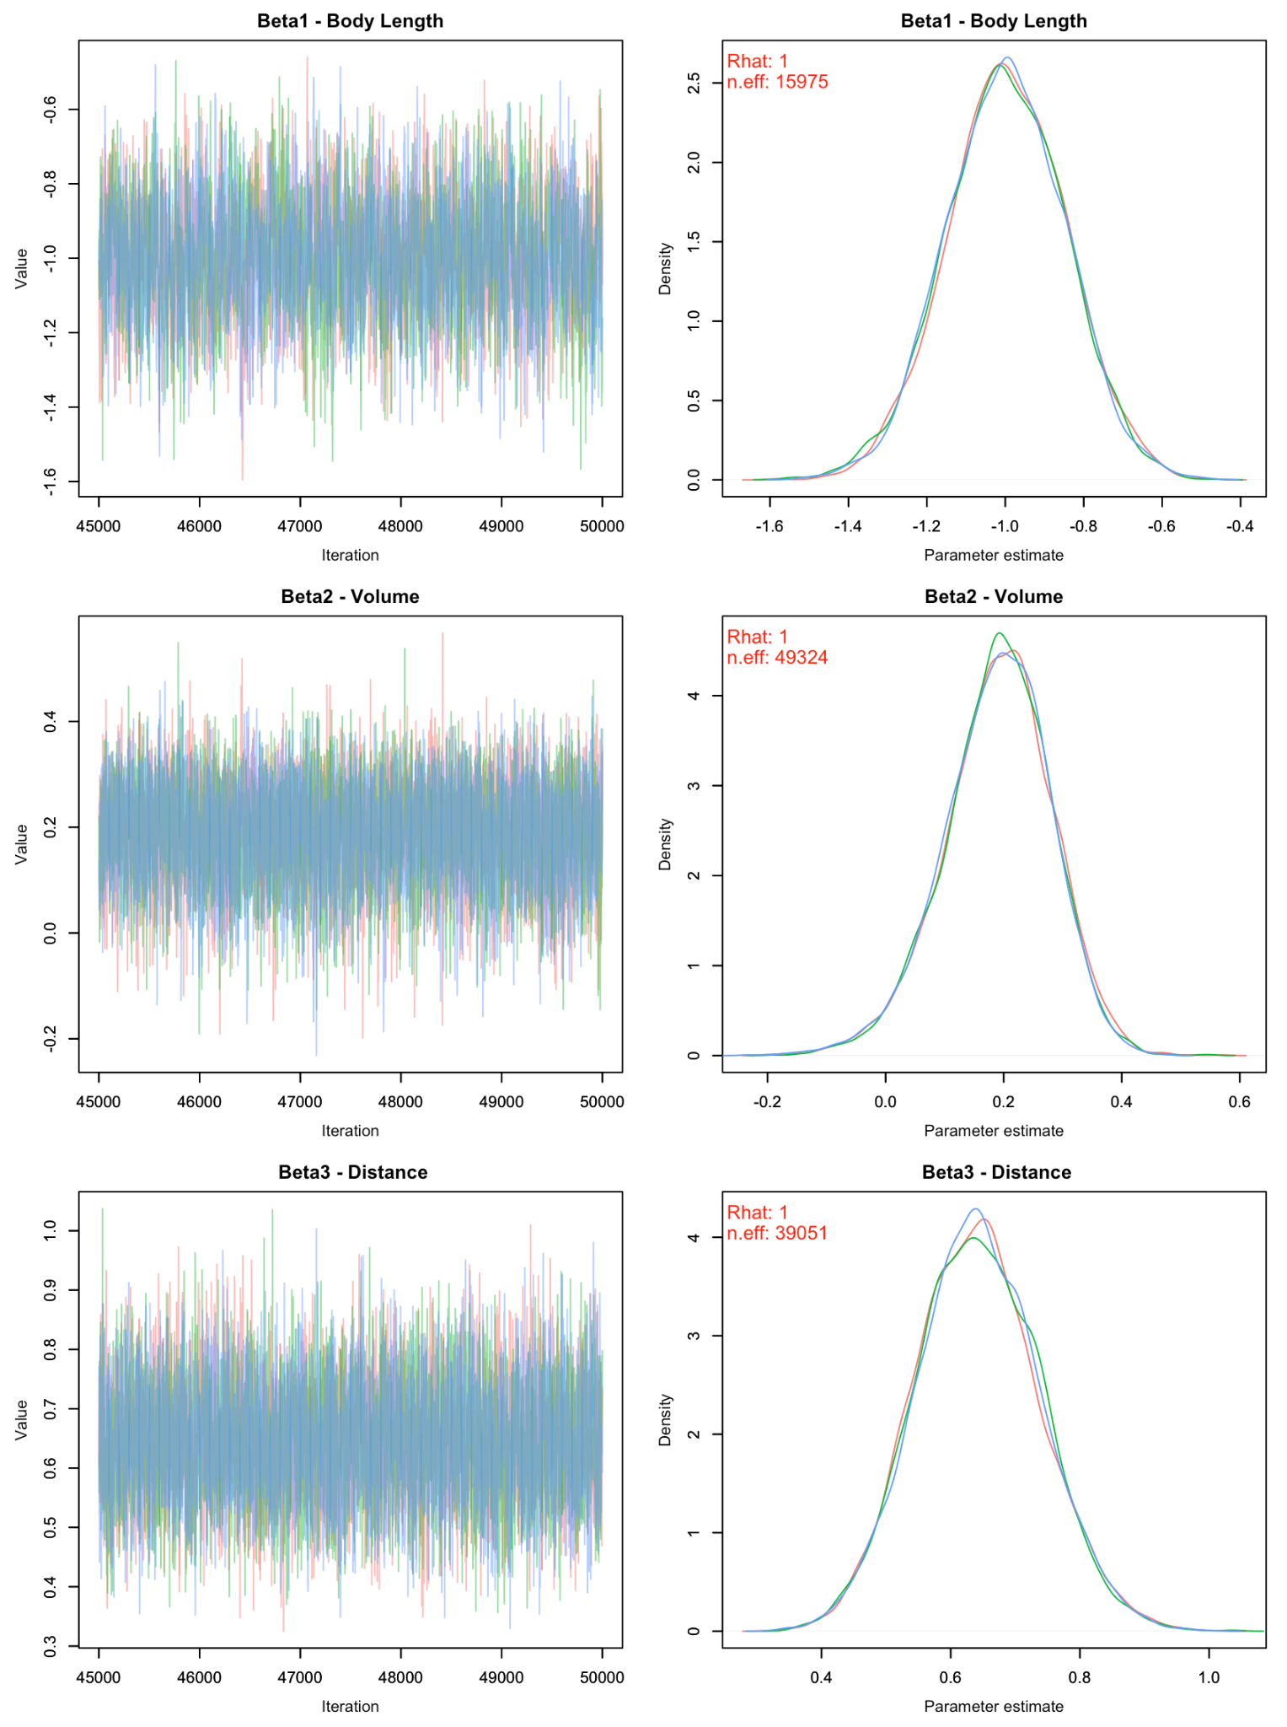
Results
Gelman-Rubin diagnostics indicated convergence for all β parameters.
Problems with volume: surface strike model.
Site effect parameters converged for the search forage, movement, surface strike, and attack forage models.
Posterior predictive checks and Bayesian p-values all indicate that the models are good fits for their respective behavior data.
Notes:
James
Gelman-Rubin diagnostics indicated convergence for all β parameters.
Visual assessment of trace plots and density plots indicated good convergence for all β parameters except for volume in the surface strike model.
Site effect parameters converged for the search forage, movement, surface strike, and attack forage models.
Due to 95% credible interval overlap, significance is only indicated for site 2 in the movement model and site 6 in the search forage model.
Posterior predictive checks and Bayesian p-values all indicate that the models are good fits for their respective behavior data.

Slide 16
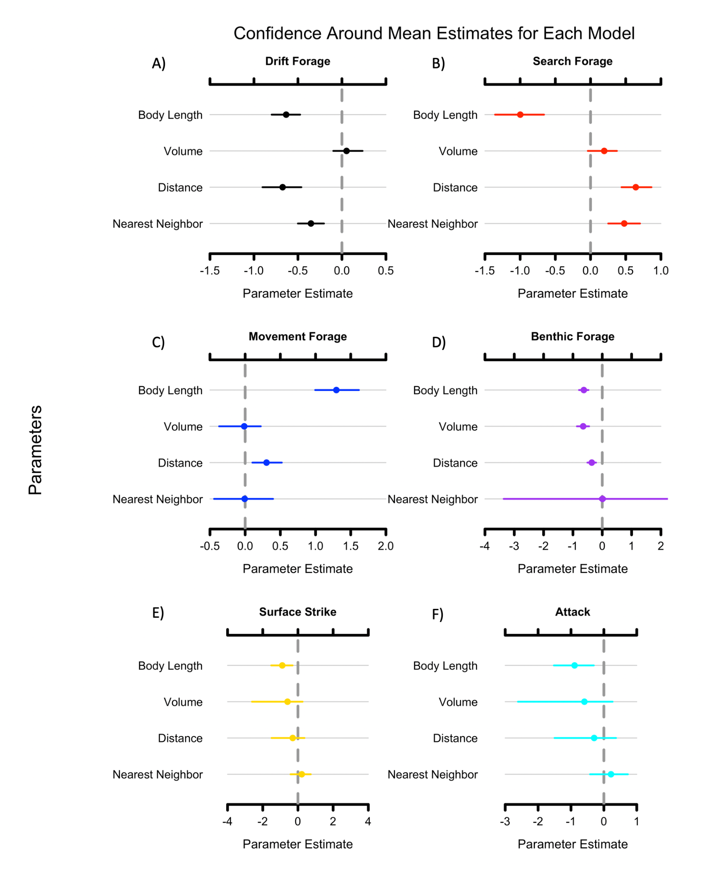
Posterior Means for Parameter Estimates
95% credible intervals overlapping zero may still be significant...
Overall, negative parameter relationships with covariates except for search foraging and movement.
Movement
Notes:
James

Slide 17
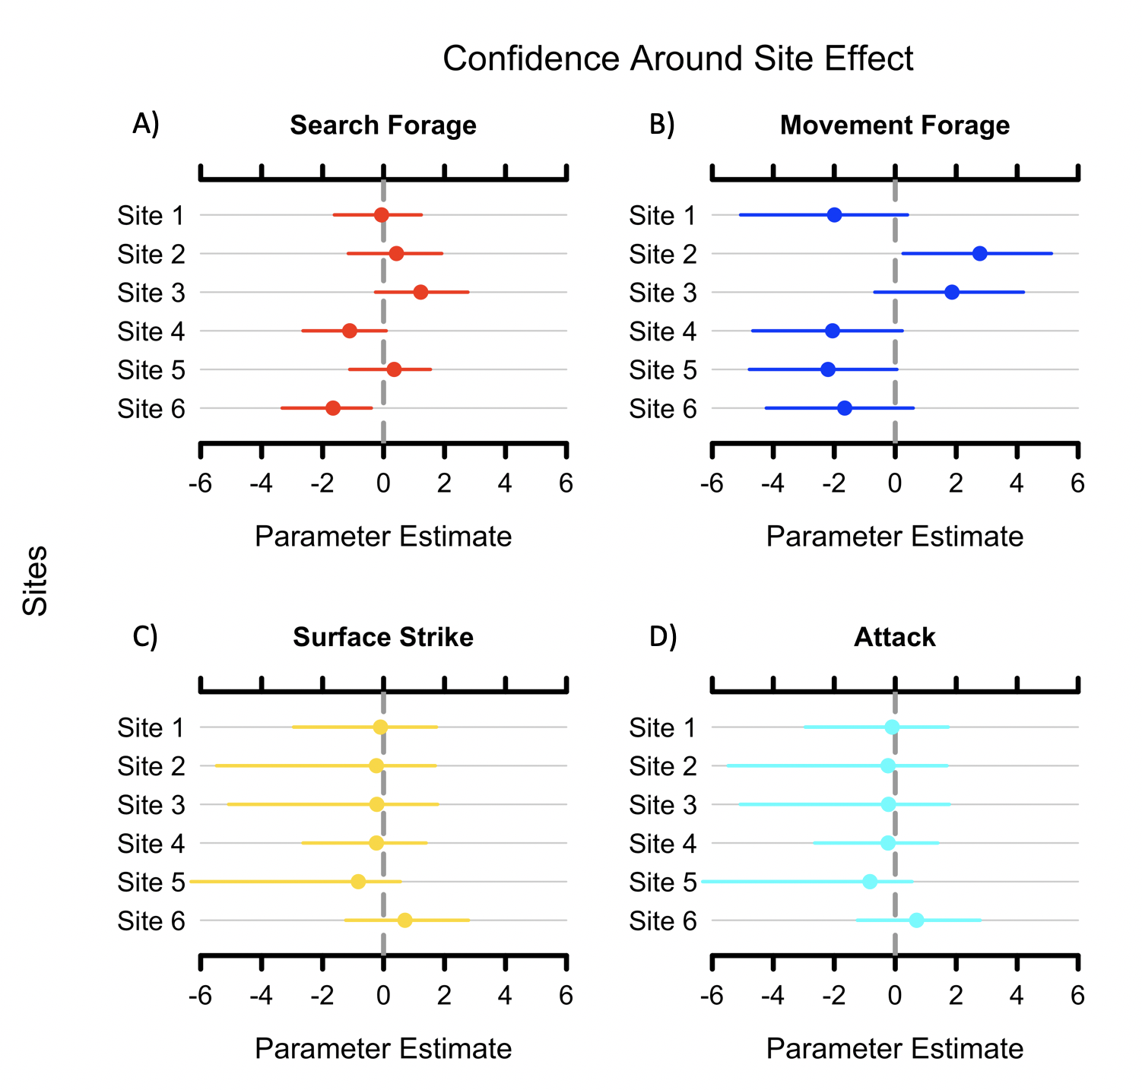
Posterior Means for
Site Effects
Movement
95% credible interval overlap with zero indicates few strongly supported relationships between site effect and probability of behavior.
Notes:
James

Slide 18
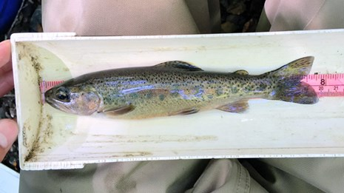
Strongest Correlations Suggesting by Analysis
Results indicated that body length had strong correlation to all foraging behaviors and movement.
Results indicate that distance traveled has an effect on most foraging behaviors except for surface and attack foraging.
Minimal correlations between site and foraging behavior are indicated by the results.
National Parks Service

Slide 19
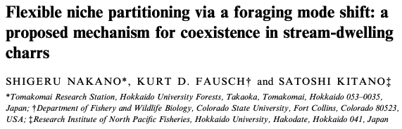

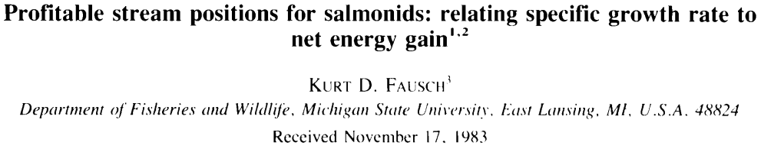
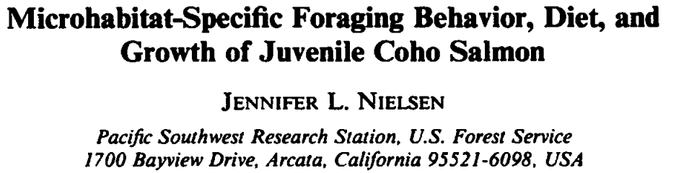
Implications of Results
Findings consistent with previous literature:
Drift foraging fish show little movement
Smaller fish are more likely to benthic forage
Search foraging is less common amongst larger fish
Search foraging increased with larger occupied volumes
Notes:
Keane

Slide 20
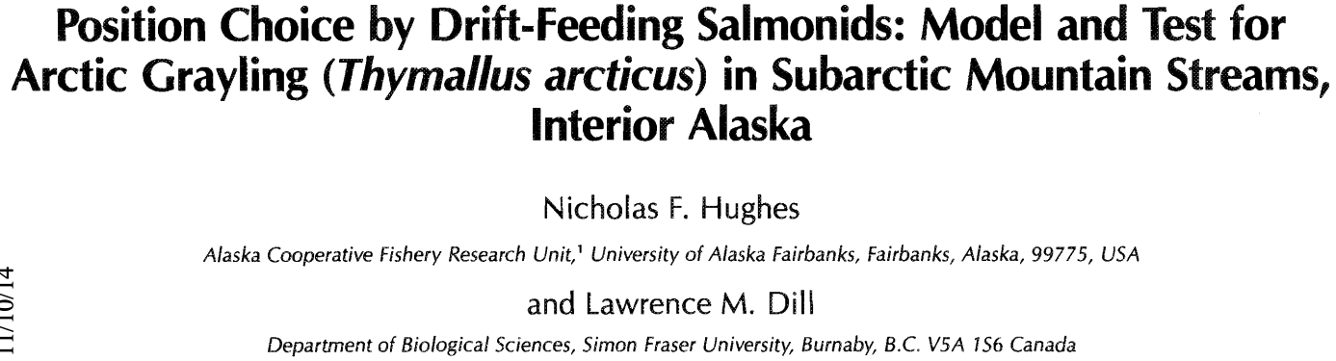
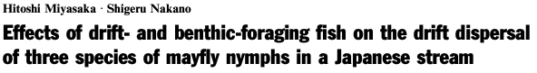
Implications of Results
Deviated from findings of previous studies:
Decrease in drift forage with increase in fork length
Benthic foraging is more common over smaller patches
Notes:
Keane

Slide 21
Implications of Results
Why do we care about these findings?
Most of fisheries restoration planning is based off of hydrology planning derived from fish foraging theory
Most of those hydrology planning tools are incredibly outdated
Still used as an industry standard since the late 1970s (Bovee & Cochnauer 1977)
A need to shift paradigm away from hydrology-based restoration and focus on NREI modeling
Notes:
Keane: should we include surface strike and attack models too?

Slide 22
Acknowledgements
We thank Dr. Kevin Shoemaker (University of Nevada, Reno) for providing guidance on all aspects of this study; we thank Madeleine Lohman (University of Nevada, Reno) for providing guidance regarding statistical analyses; we thank Mary Power and Ted Grantham’s labs for funding the data collection; lastly we thank the technicians and volunteers who assisted in the field.
Notes:
Do we need this slide?

Slide 23

Appendix
See R Code and corresponding documentation at the following GitHub page:
https://github.com/keaneflynn/NRES746-FinalProject
Notes:
Do we need this slide?

Slide 24
Questions?
Notes:
Keane

